Slide 1
FILE PERMISSIONS/FOLDER PERMISSIONS
PRESENTED BY:
Name:R.Sathya soroopan B.tech

Slide 2
INDRODUCTION:-
What is File Permissions?
Brief explanation: Controls who can read, write, or execute files and directories.
Importance: Protects files and maintains system security.

Slide 3
TYPES OF FILE PERMISSIONS
Two types of file permissions are there,
1.Symbolic method(r,w,x)
2.Numerical method.(r=4,w=2,x=1)

Slide 4
TYPES OF USERS
User Categories:
Owner (u) – Creator of the file
Group (g) – Users within the same group
Others (o) – All other users
rwx rwx rwx
u g o

Slide 5
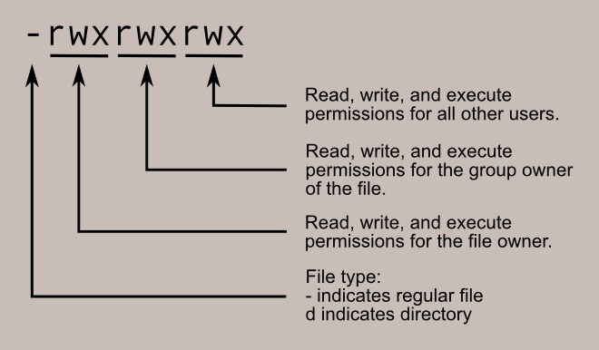
FLOW CHART

Slide 6
Example:
-rwxr-xr-- :it means,
OWNER:read,write,execute.
GROUP:read,execute.
OTHERS:read.
To viewing the file permissions,
Command: ls –l (list of permission)
Command: ls –ld (detailed permission)

Slide 7
Assign the file permssion in symbolical method,
chmod => change modifications
/#chmod u=rwx ,g=rx,o=r file name
=sets specific permissions
+adds permissions
-removes permissions.
Example:
Chmod u+x file name
(user will assign execute permission)
Chmod u-rw file name
(user remove read&write permissions)
Chmod o+x file name
(others only execute permissions)

Slide 8
NUMERICAL METHOD
Permissions can also be represented in numeric notation,
Read =4
Write =2
Execute =1
Standerd value of the file=644(-rw-r--r--)
Standerd value of the directory=755(drwxr-xr-x)

Slide 9
SINTEX FOR NUMERICAL METHOD
Example: /# chmod 742 file name
-rwxr---w-
/# chmod 600 file name
-rw-------
Recursive functions:-(-R)
It carres the inhertance of the folder to all the files.
Create the folder,
/# mkdir folder name
/#cd folder name (inside the folder)

Slide 10
In side the folder create the file,
Cd new/# touch k1 k2
:/# cd
:/# chmod –R 765 folder name
It make all the files present as recursive permission as that of the folder.

